Slide 1
Transport Layer

Slide 2

Notes:
Transport services and protocols provide logical communication between app processes running on different hosts.
Transport protocols run in end systems, on the send side, it breaks app messages into segments and passes them to the network layer. On the receive side, it reassembles segments into messages and passes those messages to the app layer.
There are more than one transport protocol available to apps: the ones found in use on the internet (and all common networks) are TCP and UDP.

Slide 3
Network Layer
Transport Layer
Notes:
The network layer is the logical communication between hosts, while the transport layer is the logical communication between processes (it relies on and enhances network layer services).
Postal example (12 kids send letters to kids in another house, the hosts = houses, processes = kids, app messages = letters in envelops, transport protocol = parents, network protocol = postal service)

Slide 4
Network Layer
Transport Layer
Notes:
If we want reliable, in-order delivery, we will want to use TCP, as we discussed last week, it offers us: congestion control, flow control and connection setup
If we’re ok with unreliable, unordered delivery, we use UDP, which is a no-frills extension of “best-effort” IP (Internet Protocol)
Neither of these protocols offer us delay or bandwidth guarantees.

Slide 5
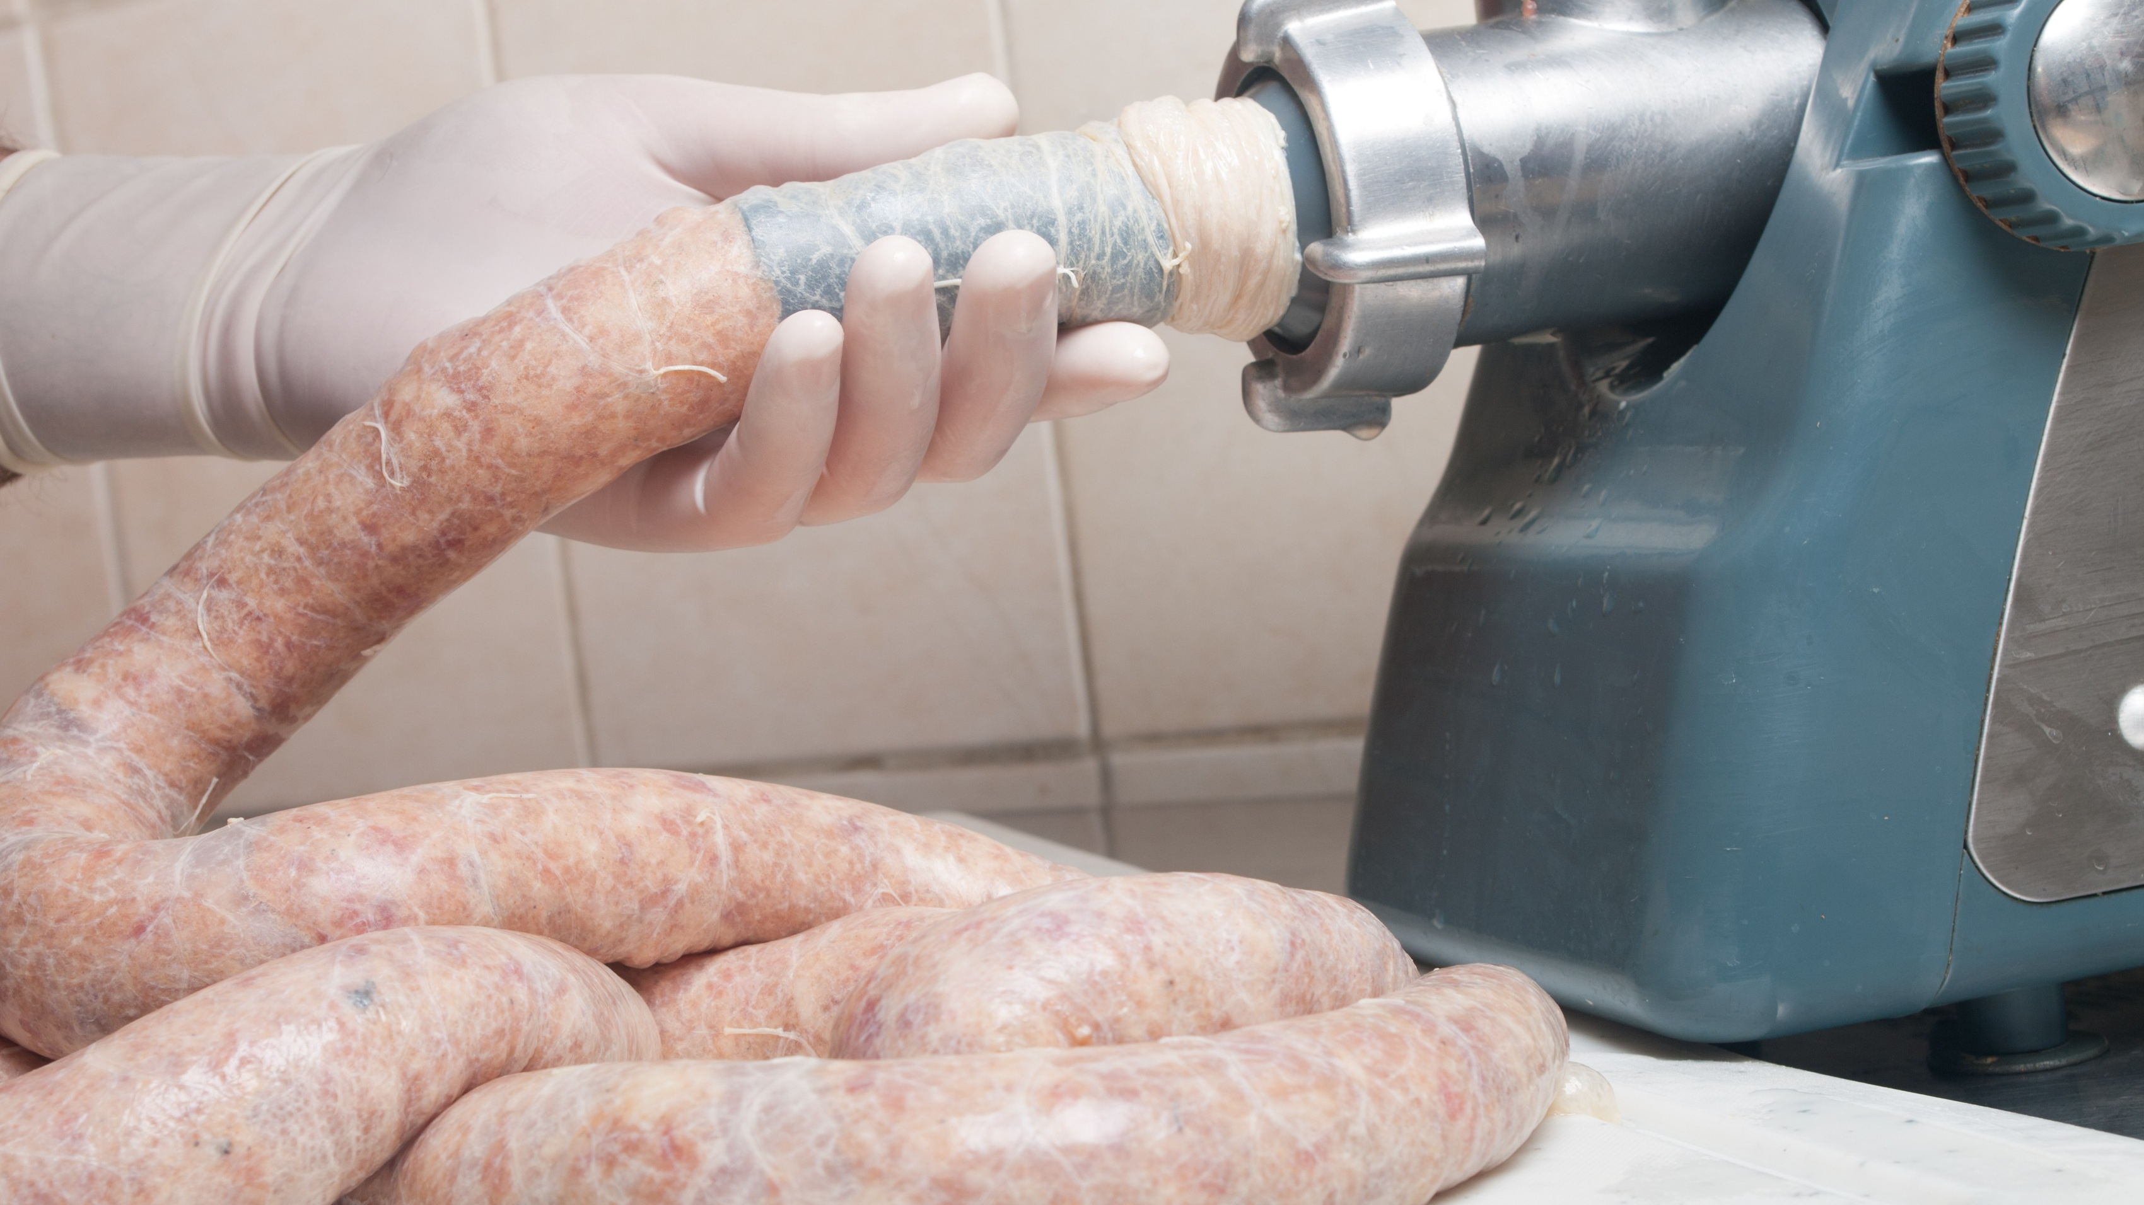
Notes:
We can’t just fling packets of data down the network connection – we would quickly overwhelm the bandwidth and grind the entire thing to a halt. Instead, the network protocol does something called multiplexing and demultiplexing.
When we send messages, the system takes messages from multiple sockets and combines it all together under a single transport header.
When the receiving machine receives the ‘lump’ of info, it uses the header info to deliver the received segments to the correct socket.

Slide 6
Notes:
The host receives IP datagrams, each datagram has a source IP address *and* the destination IP address, each datagram carries on transport-layer segment and each segment has source and destination port numbers.
The host pulls the IP address and port numbers and uses those to direct the payload (segment) to the appropriate socket.

Slide 7
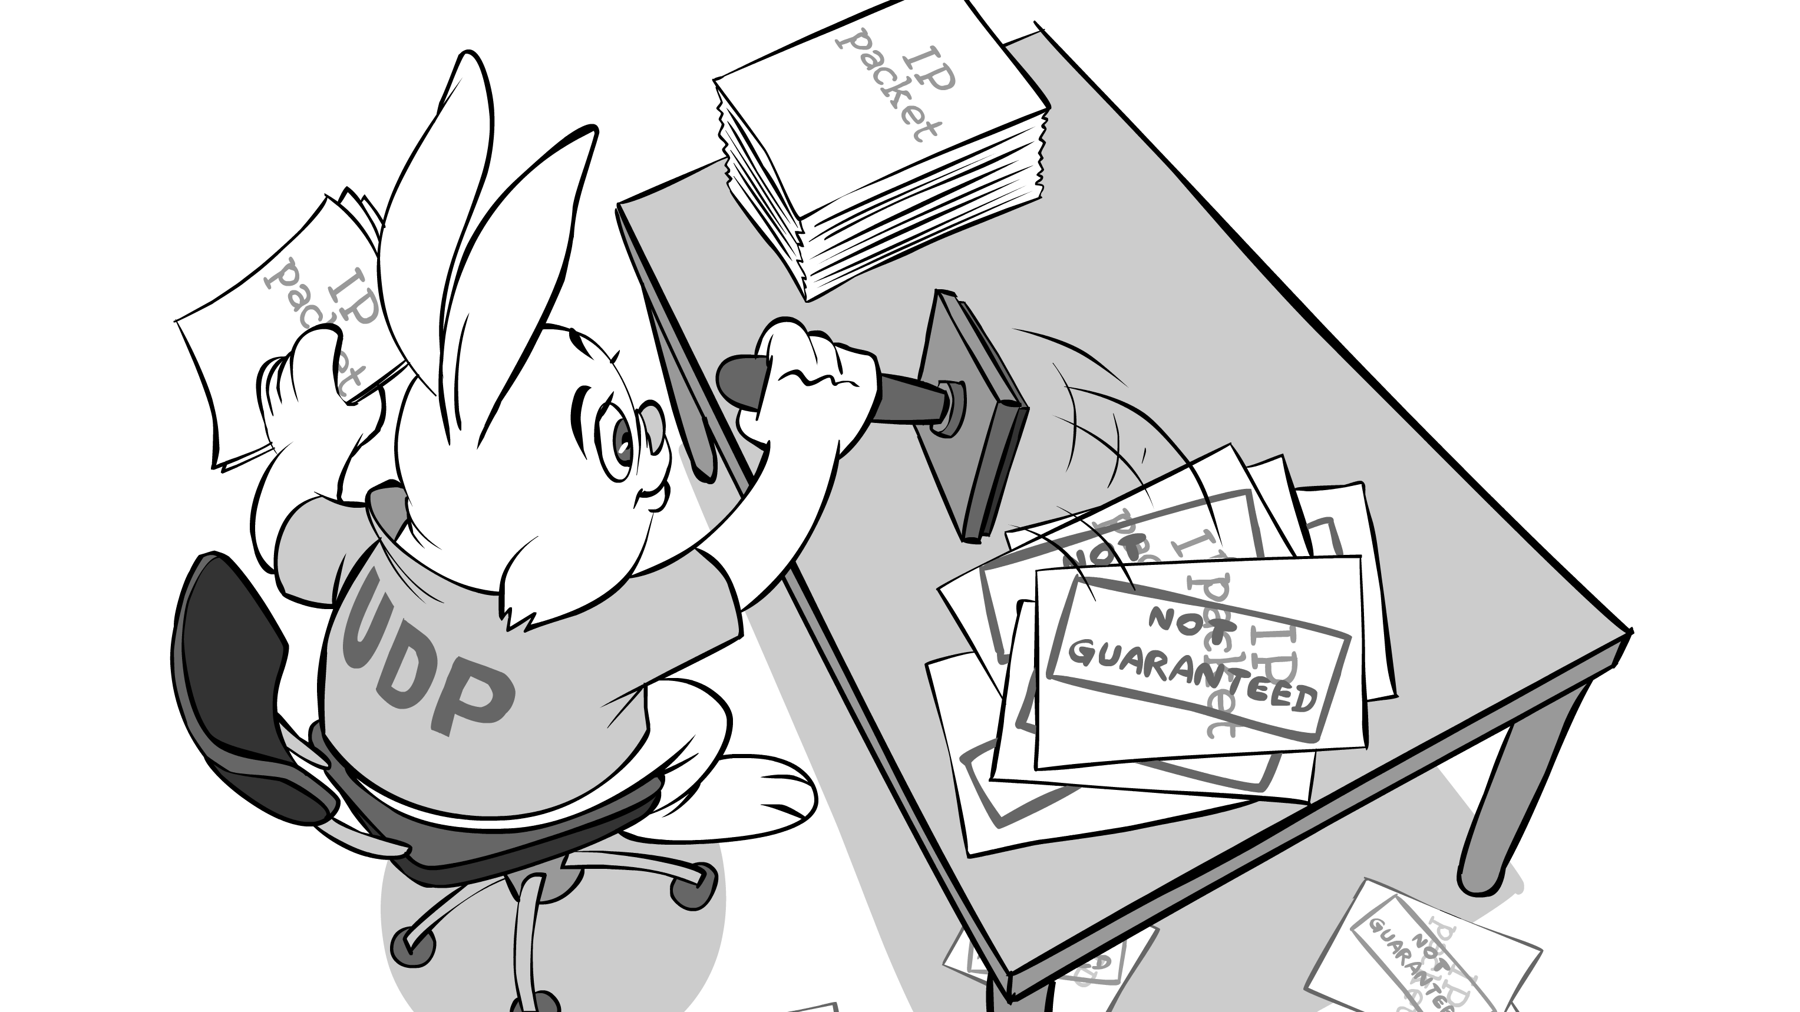
Notes:
UDP or User Datagram Protocol (RFC 768)
No frills or barebones internet transport protocol, it’s a best effort services, UDP segments may be lost or delivered out of order to the app.
It’s connectionless, so there’s no handshaking between the sender and receiver, each segment is handled independently of others.
We typically see it being used for streaming multimedia (loss tolerant, but rate sensitive) – which also include games.

Slide 8
Notes:
To make transfer reliable over UDP we need to add reliability at the application, with application-specific error recovery.
Why is there a UDP? No connection establishment (so no associated delay), it’s simple with no connection state at either end, it has a small header size and it can blast away as fast as possible as there is no congestion control.

Slide 9

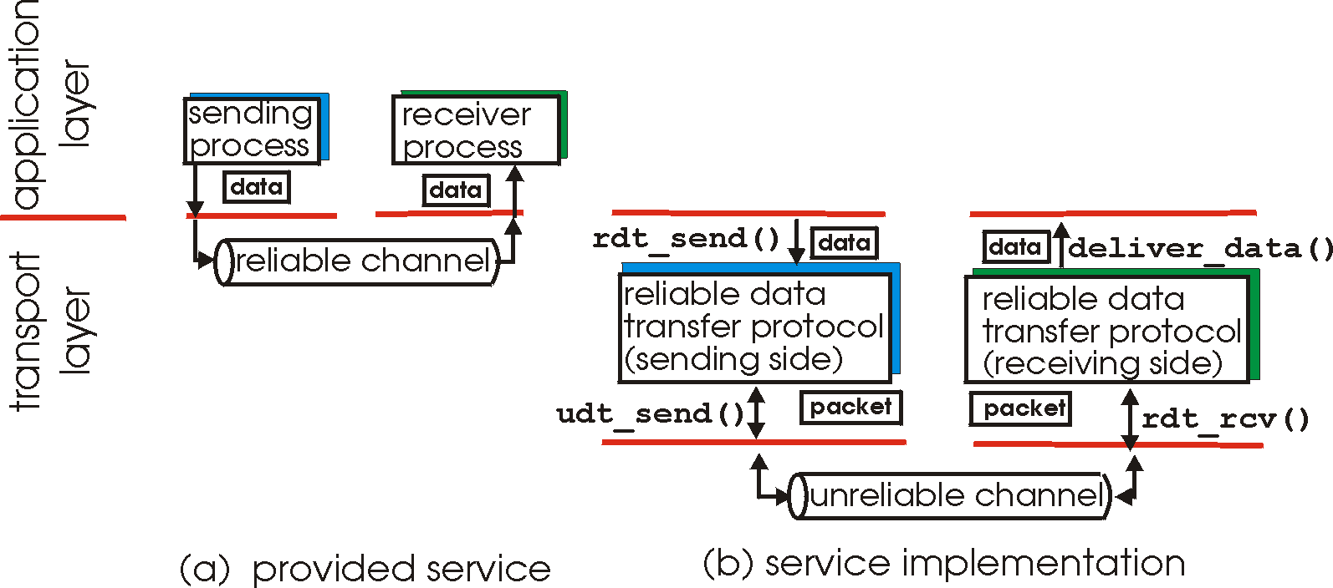
Notes:
Reliable Data Transfer (rdt) is important at the application, transport and link layers – it’s considered to be one of the most important networking topics!
The characteristics of the unreliable channel determine the complexity of the rdt protocol.
In a perfect world, there would be no bit errors and no loss of packets between hosts, but that doesn’t exist outside of research labs, so we need to think about ways of handling both of those issues.
Consider bit errors – where a bit gets flipped in the message during transmission (so a 0 becomes a 1 or vice versa) – how do humans recover from “errors” during a conversation? We ask for the information again (generally).

Slide 10

Notes:
We detect errors using something called a checksum (which is a digit that represents the sum of correct digits in a piece of data) – which lets us find flipped bits (we would have incorrect digits, so when summed up, the checksums would not match).
But how do we recover from that as a computer? We send acknowledgements (or ACKS) – where the receiver tells the sender that they got a packet OK.
If a packet is “bad”, we send a negative acknowledgement (NAK), if the sender gets a NAK, it resends the packet.
But what if the ACK/NAK gets corrupted? The sender doesn’t know what happened at the receiver – if we just retransmit, we might send a duplicate packet. To handle that, we include a sequence number in each packet – if the receiver gets a packet with a sequence number it’s already seen, it can discard it. (in this case, the sequence numbers are either 0 or 1)

Slide 11
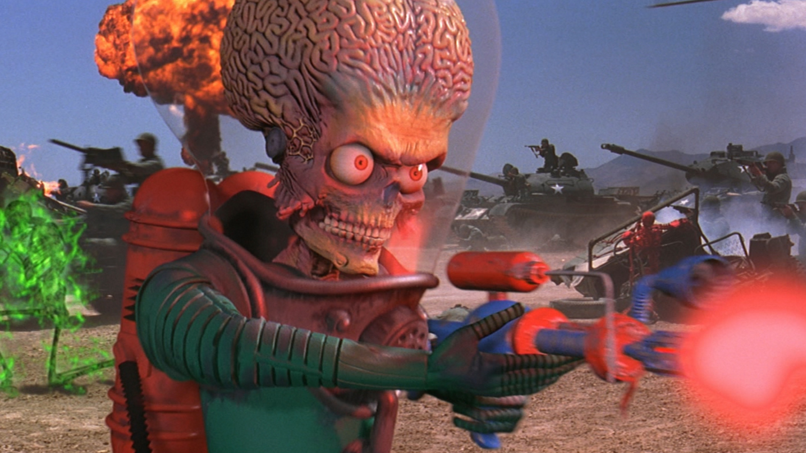
Notes:
So that lets us handle flipped bits, but what about packet loss?
We can have the sender wait for a period of time for an ACK response after it sends a packet, if there isn’t one, it retransmits the packet. Even if the packet is just delayed, because we’re sending a duplicate sequence number, we already handle that.
But now we need to track a countdown timer – this is great and all, but we get terrible performance, because we’re waiting for the timeout before sending the next message, we’re greatly restricting our throughput. So even on a gigabit connection, we’d be using a tiny amount of it. So the network protocol limits the use of physical resources!

Slide 12
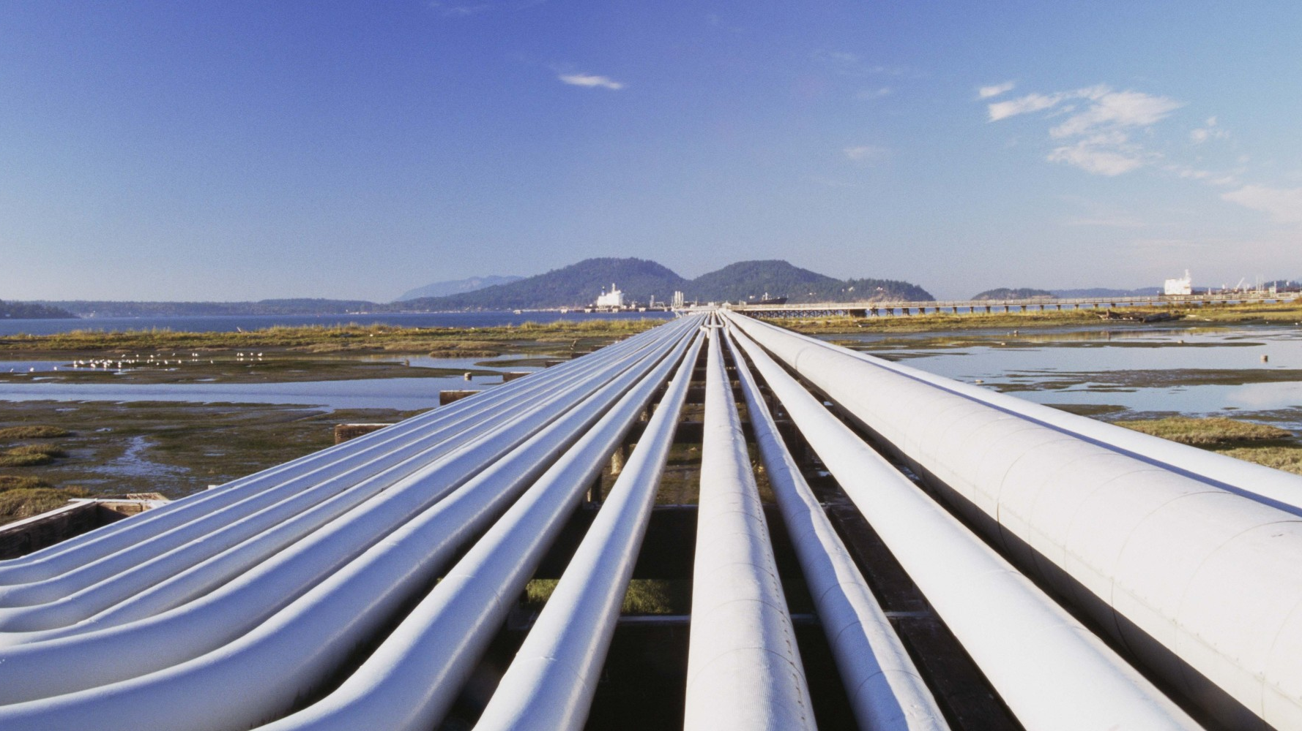
Notes:
To speed this up, we can pipeline our protocol – so the sender allows multiple “in-flight” but yet to be acknowledged packets (so we need to increase sequence number counts) and we buffer those packets at either the sender or the receiver. We can either have the receiver individually acknowledge (ACK) all correctly received packets or we can accumulate a singular ACK that accounts for a range of packets.

Slide 13
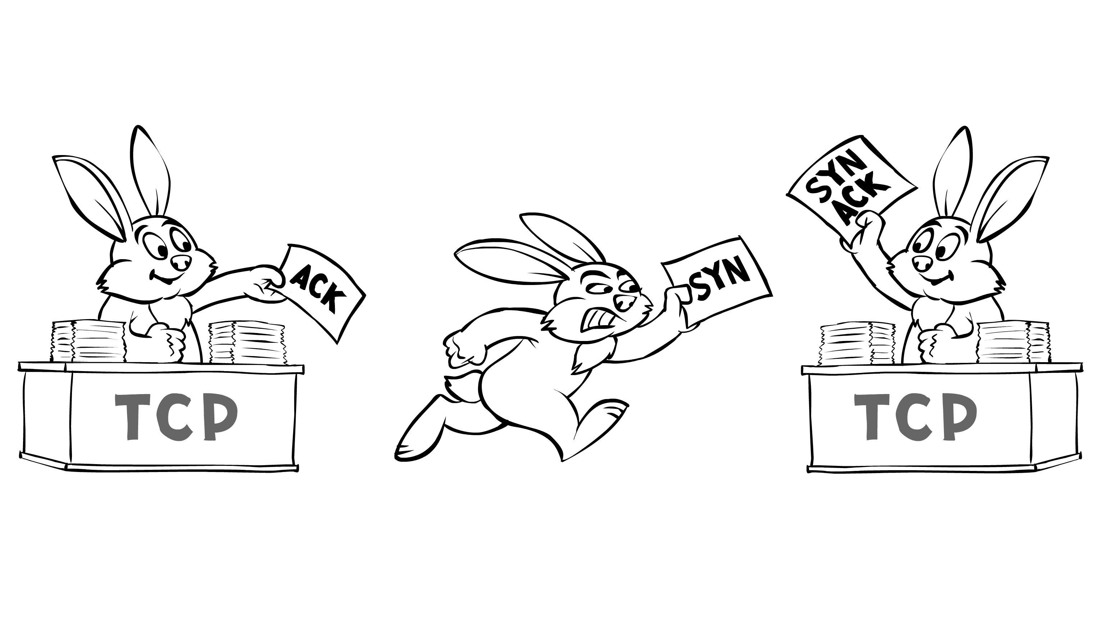
Notes:
TCP or Transmission Control Protocol (RFCs 793, 1122, 1323, 2018 and 2581)
It’s a point-to-point protocol, with one sender and one receiver at a time. And those hosts send a reliable, in-order byte stream between each other through a pipeline that does congestion and flow control (the sender will not overwhelm the receiver). It offers us full duplex data; so bi-directional data flow in the same connection.
We have to perform a handshake between hosts that inits the state of the sender and receiver before any data is exchanged.

Slide 14
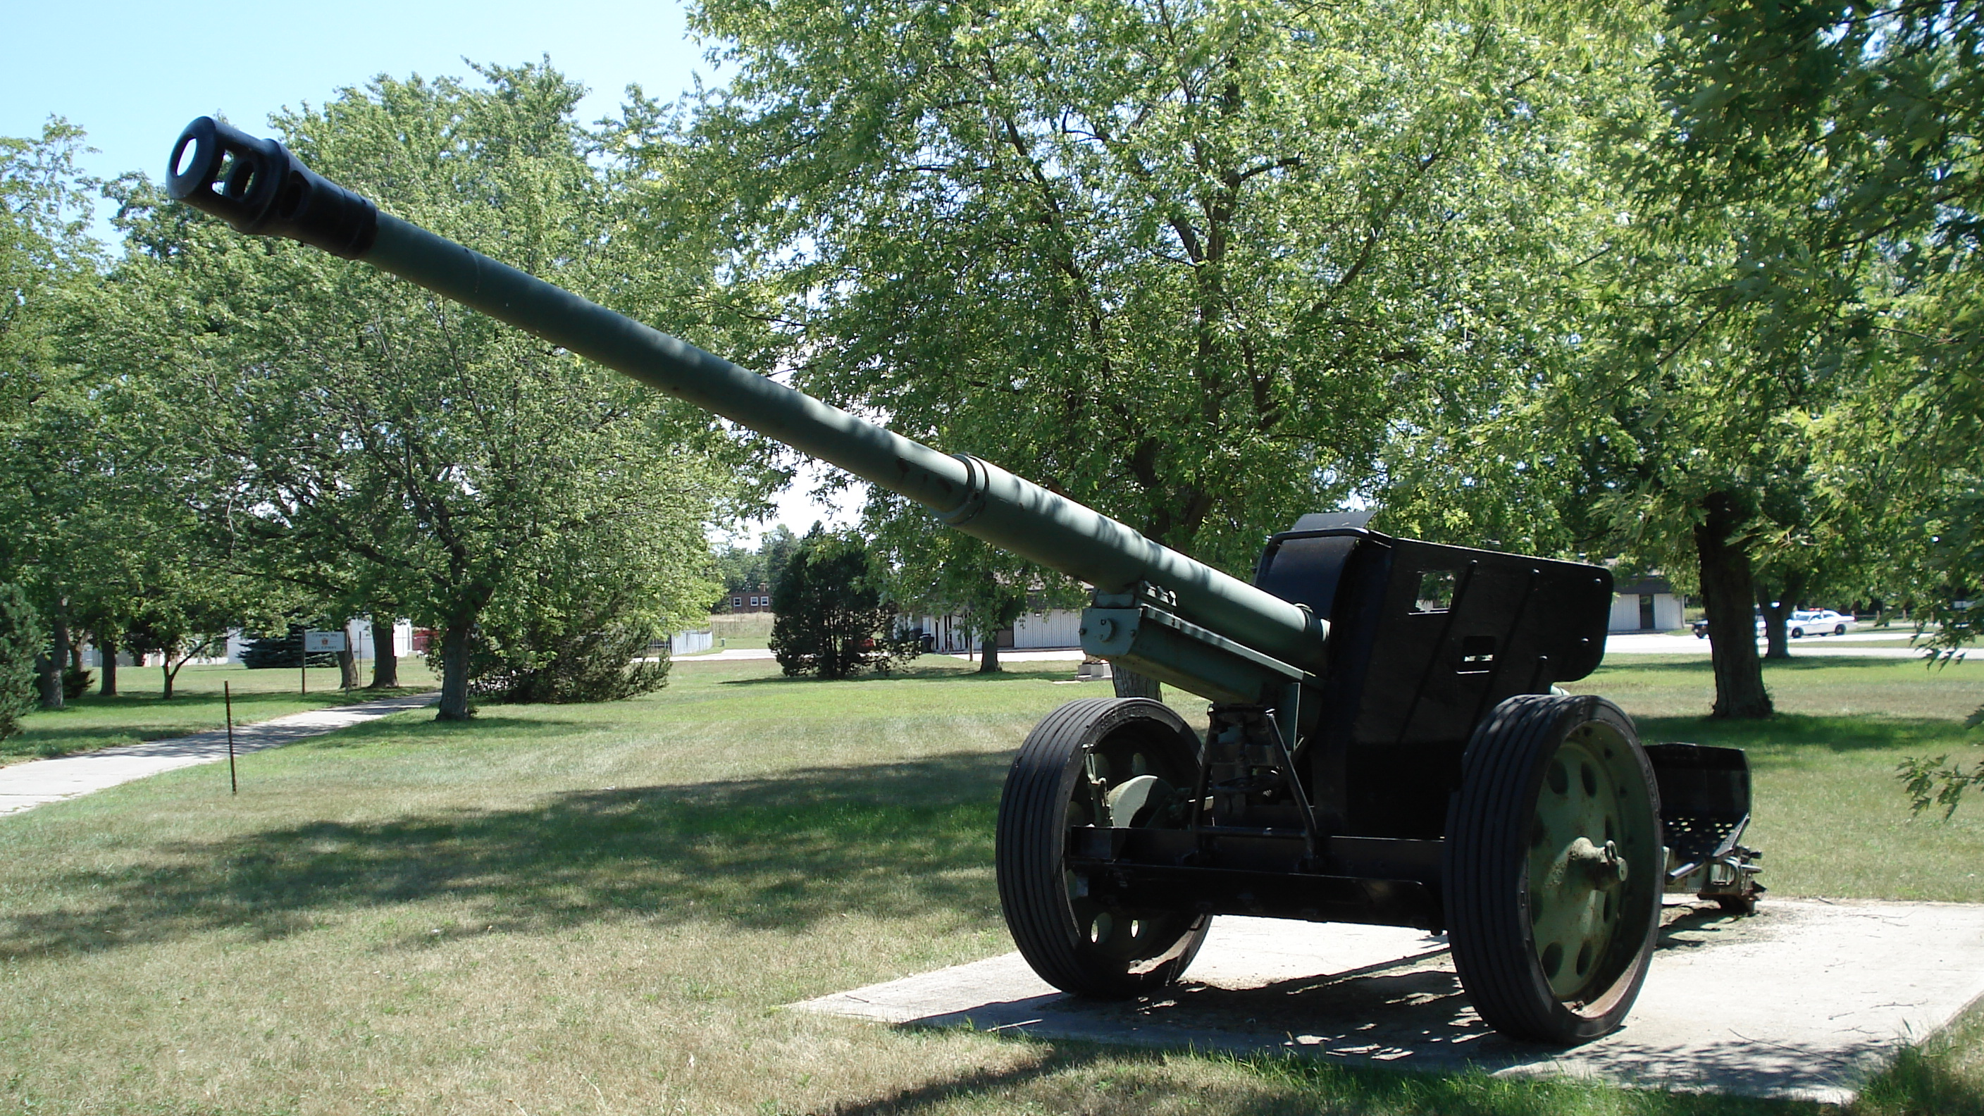
event at receiver
arrival of in-order segment with
expected seq #. All data up to
expected seq # already ACKed
arrival of in-order segment with
expected seq #. One other
segment has ACK pending
arrival of out-of-order segment
higher-than-expect seq. # .
Gap detected
arrival of segment that
partially or completely fills gap
TCP receiver action
delayed ACK. Wait up to 500ms
for next segment. If no next segment,
send ACK
immediately send single cumulative
ACK, ACKing both in-order segments
immediately send duplicate ACK,
indicating seq. # of next expected byte
immediate send ACK, provided that
segment starts at lower end of gap
Notes:
What all this means is that TCP builds in our ACK system that we just specified, even down to the timeout value – but we need to specify the timeout that’s acceptable to minimise the impact on our throughput. To figure this out, we need to make a bit of a guess: it needs to be longer than the round trip time (if it’s too short, we get premature timeout) if it’s too long, we get a slow reaction to segment loss. We can measure the time from segment transmission to ACK receipt for several recent packets and average the time for our RTT value.
So TCP ACK generation looks something like this:

Slide 15
TODO
Start thinking about your chat protocol:
Feel free to look at the IRC RFC for some ideas
https://tools.ietf.org/html/rfc2812.html
Just don’t copy it exactly!
Think about the scope of your system and the complexity you have to handle
Remember that you will be implementing this…

